Slide 1
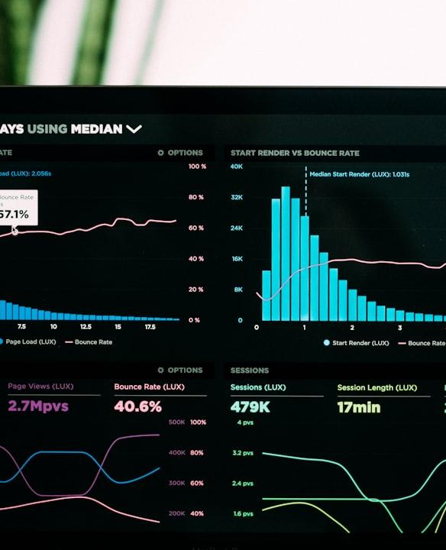
Data Profiler Automating Data Profiling for Regulatory Reporting
TEAM MEMBERS
Pulkit Gupta
Sakshi Jain
Rudra Pujara
Madhurim Gupta

Slide 2
Contents
1
Overview of Data Profiling
5
Application Images
2
Flowchart
6
Conclusion
3
Key Components
4
Technologies Used

Slide 3
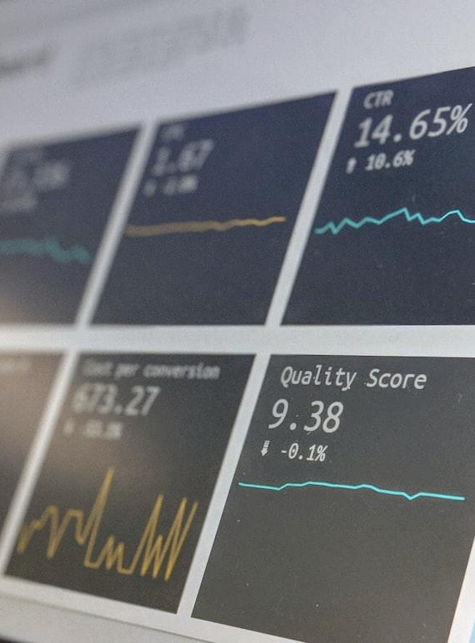
Overview of Data Profiling
Understanding Data Profiling
In the banking sector, regulatory reporting requires the compilation of large volumes of data to meet compliance requirements.
A key part of this process is data profiling, which ensures that the data reported aligns with specific regulatory guidelines.
Traditionally, this task is performed manually, with profiling rules defined based on the underlying data and regulatory instructions.

Slide 4
Flowchart
Rules Extraction
Extracted regulatory reporting instructions from Federal PDF
Data Feeding
A .csv file containing around 50 data rows were fed into the model.
Reporting Anomaly
Detected anomaly from the test data using the rules that were generated from the PDF

Slide 5

Key Components
Sample Dataset
Initial test data was prepared using GenAi model ChatGPT. Sample dataset consisted of 50 data rows with columns such as transaction amount, balance before and after transaction, sender and receiver details, etc. were included.
Prompt
A prompt is included in the application through which any extra rules can be added to the set of rules by the user.

Slide 6
Technologies Used
Frontend and Visualization
Backend Logic
Gen AI model
Streamlit, a python framework is used to build the frontend and chatbot.
Python and libraries such as pandas, re, are used to develop the logic for data processing
GenAI model OpenAI is used to process the input files and prompts is used. The LLM is used to generate rules based on the FINRA document and detect any anomaly present in the transaction details.

Slide 7
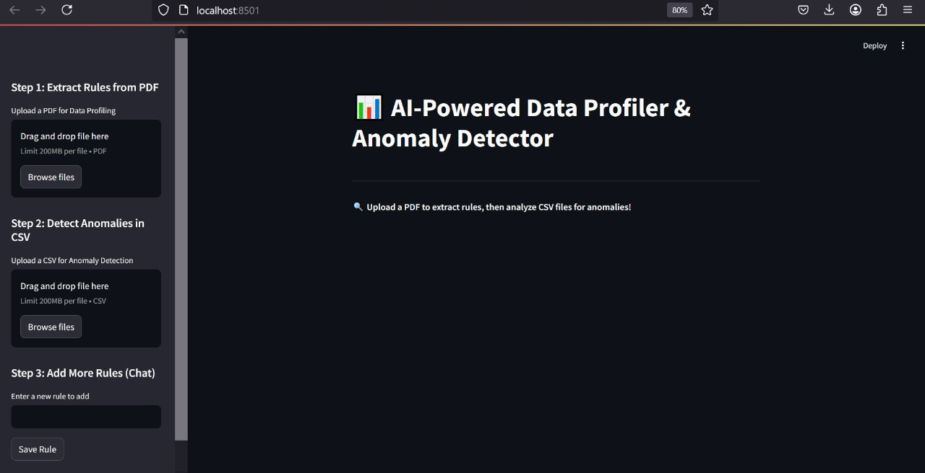
Application Images
Frontend Application accepting PDF to extract rules and transaction details to be analysed.

Slide 8
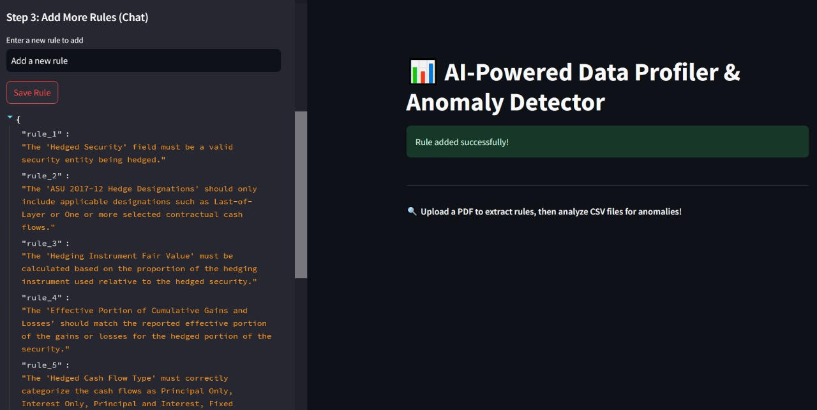
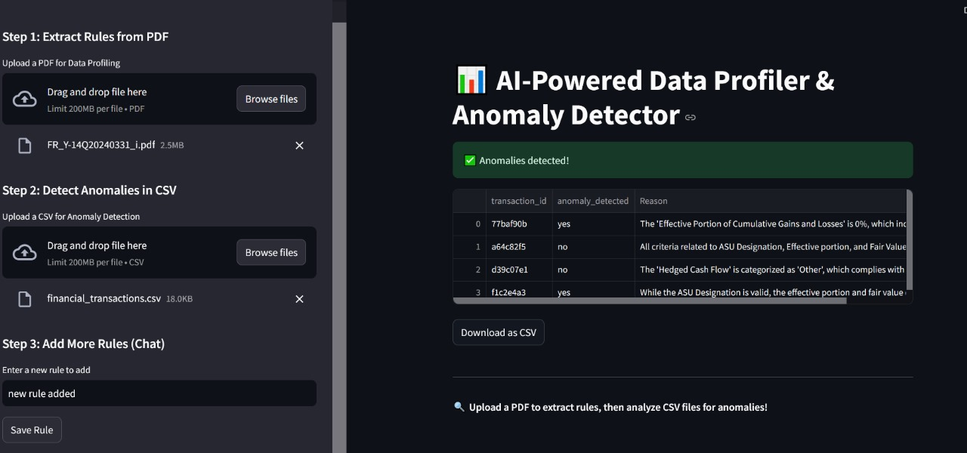
Application Images
Rules being generated
Anomalies being detected

Slide 9
Conclusion
We leveraged Generative AI to interpret complex regulatory instructions and used these rules to generate anomalies in the transaction data.
Automating the process of generating profiling rules reduces hours of manual efforts and time. AI-driven profiling ensures consistency and minimizes errors in regulatory reporting. It easily adapts to large datasets and evolving regulatory requirements.
The solution can be adapted to other industries needing regulatory compliance, such as insurance and healthcare. Future developments could include more sophisticated AI models and deeper integration with real-time data sources.

